Slide 1
In The Name Of the Father and the Son and the Holy Spirit

Slide 2
The Theotokos St. Mary

Slide 3
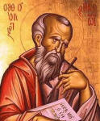
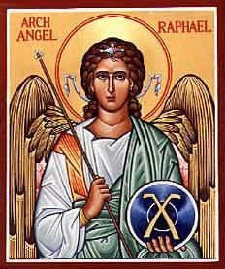
Science and Religion – Part I

Slide 4
Introduction
Our objective is to learn about how God created the earth – timeline and definitions, and to thoroughly understand Genesis 1:1-28 and connect God’s plan of creation to science and show that they are in complete harmony.
We believe in one God, the Father the Pantocrator, Make of Heaven and Earth, and all things seen and unseen.”
There are the opening words of the Nicene Creed, the central doctrinal statement of Christianity, affirm that the one True God is the source of everything that exists – both physical and spiritual, both animate and inanimate.

Slide 5
Introduction
The Holy Scriptures begin with a similarly striking assertion: “In the beginning God made heaven and earth.”
The ever-existent Almighty God was not forced to create the universe. Rather, in His goodness and lovingkindness, He freely chose to do so.
And the fact that the Lord created the universe out of nothing stands in clear contrast to the creation myths of the surrounding cultures in the ancient world.

Slide 6
Introduction
The central role of Jesus Christ, the Word of the Father, in the creation of all things is plainly stated in the first chapter of St. John’s Gospel, where it is written “In the beginning was the Word…” All things were made through Him, and without Him nothing was made that was made” (John 1:1-3).
And the specific role of the Holy Spirit, the Third person of the Undivided Trinity, in the creation of the world is seen in Genesis 1:2 (see also Psalm 103:30; 32:6).

Slide 7
The Definition of Day and Night
Definition of day and night – A day represents a period of time of light, and night represents a period of darkness.
Thus, the day that is talked about in Genesis 1 is not 12 or 24 hours. It is simply a period of light, which would be billions of years. For example, a polar day is 6 months and a polar night is 6 months.
Thus, even by today’s definitions, a day and night is not 12 hours each.

Slide 8
The Definition of Day and Night
God created the world in 6 periods of light (which God called mornings), where each period of light was preceded by a period of darkness (which God called nights.)
The 6 periods of light and darkness will correspond to certain geological events. The periods of darkness correspond to certain catastrophic geological events in the earth’s atmosphere.
As we read in Genesis, we see that there is a sequence of events in the creation.

Slide 9
The Days and Nights
Day 0: Creation of space, time, and the universe. God sets of the “big bang.” “God created the heaven and the earth (Gensis 1:1).
Day 1 night (4.5 billion years ago): “darkness was on the face of the deep” (Genesis 1:1)
Day 1 morning (3.8-3.9 billion years ago): God created light
.

Slide 10
The Days and Nights
Day 2 night: meteor bombardment separating the waters
Day 2 morning (2-3 billion years ago): God created the sky
Day 3 night: earthquakes and tectonic activity
Day 3 morning (700 million years ago): continents are formed and plant life is created

Slide 11
The Days and Nights
Day 4 night: the snowball earth due to the combined effects of tropical continents, supercontinental breakup, and equatorial flood basalt from volcanoes.
Day 4 morning (700 million years ago): the Sun, moon, and stars shine on the earth
Day 5 night: major tectonic activity resulting in massive volcanoes and earthquakes. Co2 levels rise dramatically.
Day 5 morning (550 million years ago): creation of fish, birds, and large land and sea creatures including the dinosaurs

Slide 12
The Days and Nights
Day 6 night (65 million years ago): The Cambrian explosion in which a large asteroid and many meteors hit the earth resulting in extinction of dinosaurs and many types of fish and birds and other creatures. The greatest extinction recorded in history.
Day 6 morning (7,000-10,000 years ago): creeping things, modern day mammals, and man is created in that order.
Day 7: No more creation.

Slide 13
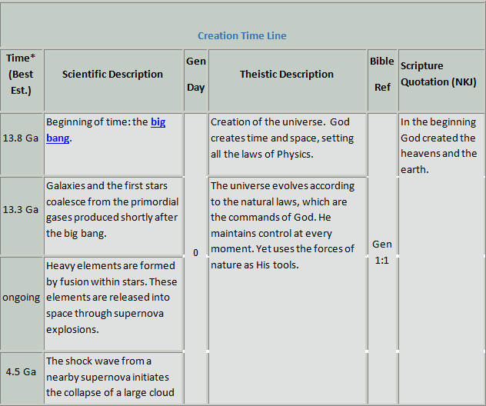
The Harmong of Science and Genesis
.

Slide 14
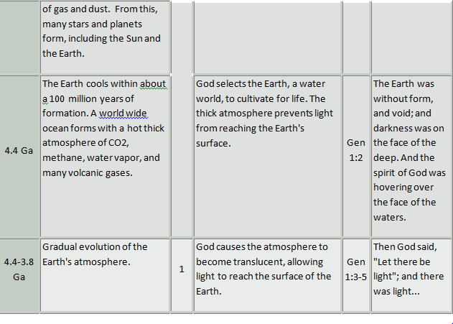
The Harmony of Science and Genesis
.

Slide 15
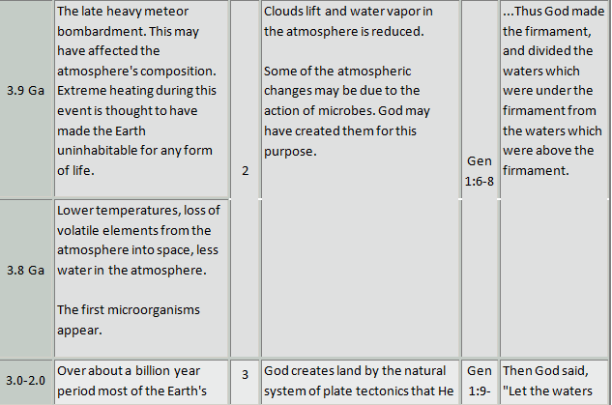
The Harmony of Science and Genesis
.

Slide 16
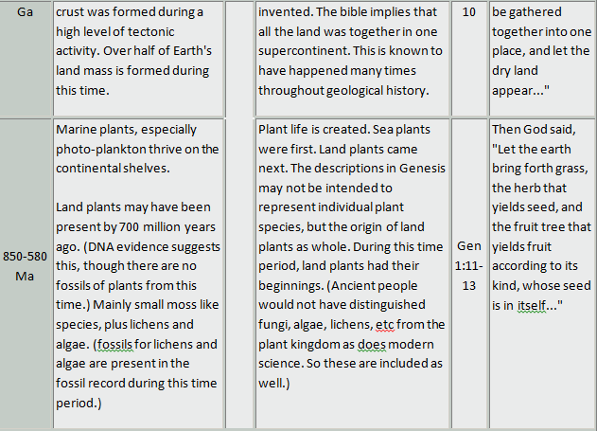
The Harmony of Science and Genesis
.

Slide 17
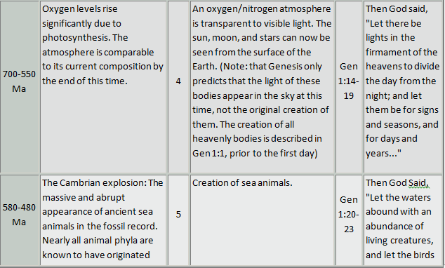
The Harmony of Science and Genesis
.

Slide 18
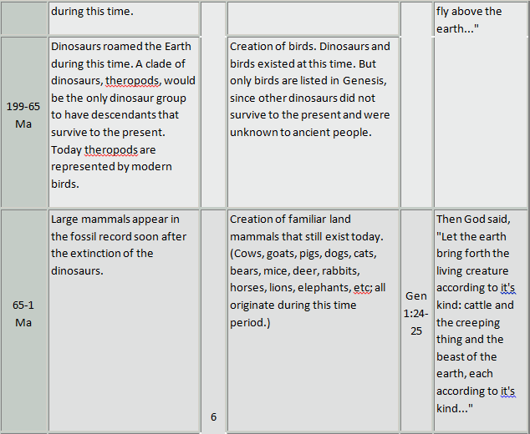
The Harmony of Science and Genesis
.

Slide 19
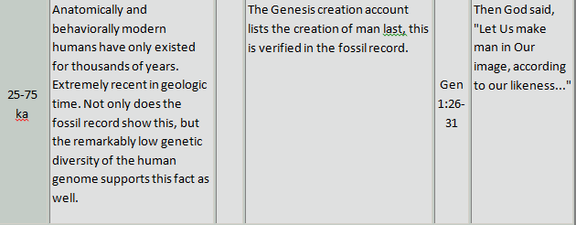
The Harmony of Science and Genesis
.

